Slide 1
Leading in an Era of Constant Change - The Head, Heart, and Hands of Transformational Leadership
Jim Hemerling
September, 2019

Slide 2
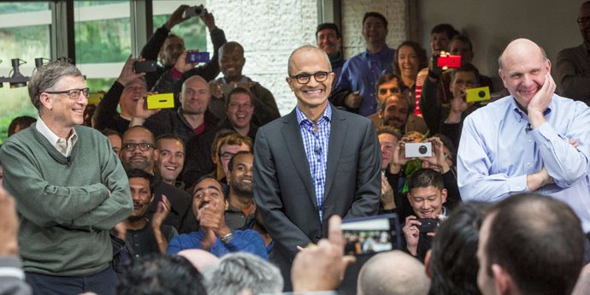
In February 2014, Microsoft announced Satya Nadella as CEO
Notes:
In February 2014...Satya Nadella, a career Microsoft engineer, was chosen to become the 3rd CEO in Microsoft's history…
While a huge opportunity... he was immediately confronted by a set of challenges...
- the ink not even dry on the Nokia handset acquisition and already it was viewed as a disaster
- Activist Investor – Mason Morfit from Value Act has just won a seat on the board
- the battle for the cloud was being won by that other Seattle based upstart AWS
- Culture: a famous meme depicted Micorosft's culture as a set of people facing inward with hand guns shooting at each other...
Bethany McLean, writing in Vanity Fair just months after Nadella became the tech giant’s CEO, wrote this: “There’s a sense in the world outside Redmond, Washington, that Microsoft’s best days are behind it, that the sprawling colossus, which employs more than 100,000 people, doesn’t know what it is, or even what it wants to be.”
As a new CEO, facing all of those challenges... What would you do? Where would you begin?

Slide 3
"Every" organization is transforming
Do you currently have a transformation underway?
A.
Yes
93.1%
B.
No
6.9%
Internet | This text box will be used to describe the different message sending methods.
TXT | The applicable explanations will be inserted after you have started a session.
Twitter | It is possible to move, resize and modify the appearance of this text box.
Notes:
93% said they were transforming...
How can that be? How can 93% of companies be transforming?
Transformation used to be a 'one-off' event for a few companies, much like a marathon. Set it up, execute, and then return to this wonderful state we called business as usual... Those days are gone...

Slide 4
Transformation is hard
Notes:
Transformation is hard.
Why am I talking about triathlons?...
It is rare these days, as AI-enabled digital transformation sweeps the business landscape, to meet a leader who hasn’t either led or been part of a transformation. Once a one-off event in response to an urgent need – a dire competitive threat, sagging performance, an overdue system or process overhaul, a post-merger integration. Today, however, companies are transforming from a variety of starting positions. Some need to move quickly to improve the bottom line. Many are not in a crisis, rather they are in need of rejuvenation. All, regardless of industry, are becoming digital. – transformation is now the new normal.
Yet from experience we know that transformation continues to be very difficult, and the evidence shows that it often fails or falls short of expectations. Moreover, it can exact an enormous toll on leaders and employees, who are constantly being asked to step up, reach further, move faster, and adapt to change, with no end in sight.
Over the years I have competed in a number of Triathlons. To be honest, I'm not very good. But I do have one distinct capability. I am remarkably fast at finding my bike. By the time I finish the swim, all the other bikes are already gone.
Just how common is transformation? We recently surveyed companies and asked them whether or not they were undergoing a transformation. The result?

Slide 5
We have entered a new era of 'Always On' transformation
Sustain
Sustain
Deliver
Launch
Sustain
Deliver
Launch
Deliver
Launch
Notes:
We have entered a new era I have dubbed the era of 'Always-On' Transformation. For leaders and employees alike, it's less a marathon and more a triathlon; no sooner does on leg finish than another is under way, giving participants no chance to catch their breath before giving their all once again.
When transformation was viewed as a one-off, short-term program, companies tended to be very short sighted and people were often treated as a means to an end or, worse, as collateral damage. But successful transformation today's environment of constant change depends on people who are embracing new tools, new methodologies, new ways of working and who are engaged and motivated to go above and beyond.
But it not just about successful transformations. The stakes are much bigger. People spend the majority of their waking hours involved in organizations. Leaders of organizations, therefore, have an enormous opportunity to have a positive impact on the lives of people. We owe it to the people who work for us and to society more broadly to find a better approach...

Slide 6
Transformation can be empowering
Notes:
Transformation can be empowering... There are companies that have embraced this era of Always-On transformation are transforming in a way that is empowering.
How? That's what I'm here to talk about. How are they transforming?

Slide 7
A reimagined holistic human-centric approach to transformation
Notes:
Slide 3: A reimagined approach to transformation
Before embarking on the journey... Satya and his leadership team stepped back and reimagined HOW they would take the transformation journey. They developed an approach that is not only holistic but also human-centric... an approach, that we have further validated by research into over 100 transformation programs, an approach that I call the "Head, Heart, and Hands of Transformation"...

Slide 8
The Head, Heart and Hands of Transformation
Envision the future and focus on the big rocks
Head
Heart
Inspire and empower your people
Hands
Execute and innovate with agility

Slide 9
Fully engaging Head, Heart and Hands is key to sustained transformational performance
(%) companies with sustained performance improvement
(%) companies with sustained performance improvement
100
100
96
Vs.
50
50
33
0
0

Slide 10
The heart and hands are often neglected
Envision the future and focus on the big rocks
69
Inspire and empower your people
Execute and innovate with agility
Notes:
As I close my presentation and open up for questions, I'll leave you with a few questions for Reflection...

Slide 11
What Microsoft has accomplished thus far
Market
Capitalization
increased from
$300B to
>$1Trillion
Massively accelerated growth in cloud platforms and services
Several $ billion in cost reduction realized
Broke down product and leadership silos with org changes
Value creation since February 2014 under Satya Nadella
New innovation model in engineering built around agile
Developed new target culture with energy around innovation
Created a "next gen" go-to-market capability
Notes:
Fast forward 5 years into their transformation, Microsoft has fundamentally transformed...
The WHAT of every transformation program is by definition going to be different. Of more interest is HOW – HOW have they approached their transformation to achieve these results?

Slide 12
The Head of Transformation
Create an aspirational vision of a digitally enabled, growth-oriented future
Communicate a compelling case for change internally and externally
Prioritize the big rocks to deliver results and create enduring value
ENVISION THE FUTURE AND FOCUS ON THE BIG ROCKS
Ensure the leadership team's alignment and commitment
Source: BCG analysis.
Notes:
The Head of transformation is envision the future and focus on the big rocks to get there... starting with creating an aspirational vision of a digitally enabled, growth-oriented future...
Bill Gates had coined the vision for Microsoft 'a PC on every desk top and in every home' which had stood the test of time for 25 years. Satya knew the world had changed dramatically. To set the new direction of travel, he articulated a new vision. The first vision he articulated was 'mobile-first, cloud-first'... signaling a fundamental departure from their PC-centric past to their future in mobile and cloud. He then focused the 'big rocks' of the transformation, aligned the leadership team, and communicated the case for change internally and externally leaving no doubt where Microsoft was heading. More than just words, Microsoft massively shifted resources and investment toward the cloud.
A few years into the transformation, in the spirit of 'Always-On' Transformation, Satya could see the world was shifting even more dramatically driven by a set of factors. First, computing is more powerful and ubiquitous from the cloud to the edge. Second, physical and virtual worlds are coming together. Third, Artificial Intelligence capabilities are rapidly advancing across perception and cognition. As such he evolved the vision to place even more emphasis on cloud and on Artificial Intelligent using the phrase: "Intelligent cloud, Intelligent edge'…
Stepping back from Microsoft, it clear that the leadership of companies undergoing transformation, need to have an aspirational vision of a digitally-enabled future, one that clearly incorporated the transformative power of AI.

Slide 13
Holistic Transformation Program
Microsoft
Vision
Culture
Strategy
Engineering
Go to market
Corporate excellence
People
Integrated Change Management
Notes:
The Satya and the leadership team launched a holistic transformation program I won't go into all the details, nor would it be appropriate for me to do so... Clearly a holistic program covering all major aspects of the business:
Culture: While not using exactly these words, it is clear that Satya believed the Transformation of Microsoft would not deliver and sustain breakthrough performance without a transformation of the culture... I mentioned the MEME with people shooting at each other.. inward, competitive, and also one of hubris – we know best.... Satya took this on. Together with Kathleen Hogan the CHRO... 4 attributes and later added a 5th: Growth Mindset – not growth as in revenues but growth as in an orientation to learning, the term coined by Stanford's Carol Dweck
Strategy: Defined the biggest strategy issues, assigned C-suite leaders against each – but made the entire leadership team accountable for solving these. what to do with nokia?, what to do with X-box, transition from Windows-centric to cloud-centric view, etc.
Engineering: many organization changes plus a major push to move away from waterfall Triad model – dev, test, program manage - to Agile
Go to market: Massive transformation – ongoing today - Digitally enabled B2B selling focused on integrated solutions
Corporate Excellence: Really a cost-reduction effort. Initially resisted cost reduction but came to see significant opportunity
People: Under new CHRO launched a People strategy and HR transformation program
…. All supported by change management to enable leaders, engage the organization, and track progress

Slide 14
Typical big rocks
Fund the
Journey
Deliver Priority
Outcomes
Build the
Organization
Simplify the organization
Simplify the product offering
Improve price realization
Reduce non-personnel costs
Growth in the core and beyond
Business model innovation
Go-to-market approach
Digital products and services
Operating model structure & roles
Leadership and talent
Core capabilities and digitalization
Culture: behaviors & context

Slide 15
For reflection…
Reflecting on the Head of your change efforts…
Can you envision the future you aspire to?
Have you defined the right big rocks?
Are you aligned as a leadership team?
Have you clarified and articulated the case for change?

Slide 16
The Hands of Transformation
Ensure executional discipline and set teams up for success
Build capabilities while executing
Entrust your best leaders with the big rocks and ensure ongoing cooperation
EXECUTE AND INNOVATE WITH AGILITY
Apply innovative methods, digital tools, and agile ways of working
Source: BCG analysis.
Notes:
The 'Hands' of transformation is metaphor for how the work is conducted.
In the era of one-off transformation with a focus on short-term, one-off improvements, transformation programs were typically executed in what one could call a 'waterfall' approach which included a diagnostic identifying a set of pre-determined actions that were then executed using rigorous program management.
In this era of 'Always-On' transformation, where the environment is constantly changing and what needs to change cannot possibly be fully determined in advance, the Hands in this reimagined approach are very different... here we not only execute and but we execute and innovate with agility...
Still need executional discipline... and teams… but what really changes in this reimagined human-centric approach is how those teams are set up for success and the innovative methods and digital tools they use.

Slide 17
Transformation Management Offices (TMO)
A
Guide transformation effort
Keep transformation on track
Communicate and support change management
Set up and structure new initiatives for success
Support existing workstreams to ensure success
Executive committee
B
TMO
C
D
E
Workstreams

Slide 18
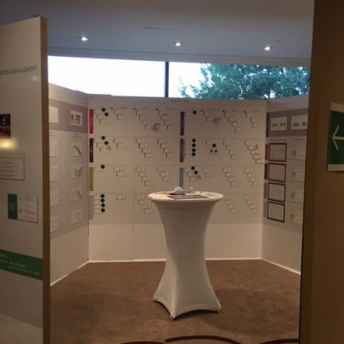
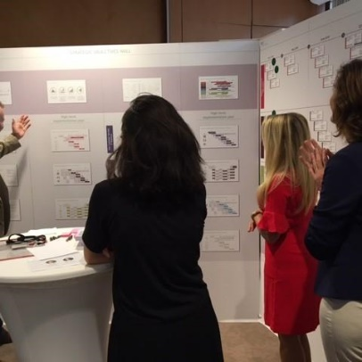
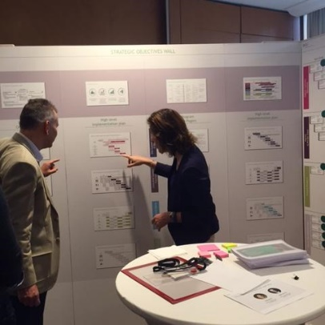
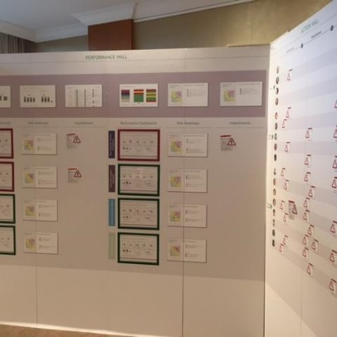
Impact Centers: enabling visual progress tracking and timely interventions
Impact Centers
Enhanced quality of interactions
Empowered leaders
and middle managers
Sharp focus on resolving issues
Disciplined and
simple routines

Slide 19
The benefits of executing and innovating with agile teams
X-functional teams
Priorities & value focus
Iterative sprints
Feedback and learning
Empowered to make decisions
Reducing 'context switching'
Reducing hand-offs, misunderstandings, rework
Faster decision making
Better solutions
Better alignment, reduced mis-understandings
Similar/consistent incentives
Higher motivation
Reduce late-stage surprises, reduce re-work
Flush out defects sooner
Higher predictability
Better stakeholder engagement
Data-driven decision making, objectivity
Avoid surprises and re-work
Higher transparency
Better responsiveness
Continuous productivity / efficiency gains
Notes:
Walk through the elements...
For all of these reasons AGILE in various forms is rapidly gaining traction as the go-to method not just for running companies but also transforming them...

Slide 20
Building critical capabilities while executing
Experiential programs
Job rotations
Stretch roles
Career paths
Action learning
Task forces
Time in field
Incorporating into daily work
Manager routines
Daily huddles
Checklists
Tip sheets
Pulse checks
Coaching and mentoring
Peer groups
Individual workgroups
Mentors
Subject matter experts
Feedback and assessment
Informal feedback
Awards, rewards
Formal reviews
Performance consequences
Formal learning
On-demand e-learning
Workshops
Defined role-based learning paths
Conferences
External visits

Slide 21
For reflection…
Reflecting on the Hands of your change efforts…
Are you ensuring executional discipline?
Are you putting your best people against the big rocks?
Are you deploying agile ways of working?
Are you building capabilities as you execute?
Are you being directive, inclusive, and delegating?

Slide 22
Heart
"Pour your Heart into it"
"Set your Heart on it"
"From the bottom of my heart"
"Not for the faint of Heart"
"The Heart of the matter"

Slide 23
The Heart of Transformation
Activate purpose to inspire employees and change the world
Create an empowering culture where people can do their best work
Lead with head, heart, and hands
INSPIRE AND EMPOWER YOUR PEOPLE
Demonstrate care for people whose lives are being disrupted
Source: BCG analysis.
Notes:
The third and final element of this reimagined approach to transformation is the Heart. INSPIRE AND EMPOWER YOUR PEOPLE. When companies are transforming, our research shows that it is the heart that is most neglected. And yet it has never been more important... Coping with constant change can take an enormous toll on people, who are constantly being asked to step up, reach further, move faster, and adapt to change with no end in sight... People are the life blood of an organization.. The Heart is central... The heart of transformation consists of four chambers of the heart – Purpose, Culture, Demonstrating care, and Leadership.
Purpose matters for many reasons. In a world of constant change and transformation, it provides an enduring North Star and a means of building resilience. It’s essential for an engaged workforce: a powerful intrinsic and emotional motivator for those (especially millennials) who seek more than a paycheck. It can improve hiring prospects, and it can mitigate attrition by creating a durable bond with employees—which is particularly important for the technology sector, where the war for talent is fierce.
When Satya kicked of the transformation of Microsoft, even though he was faced with enormous pressures, he actually stepped back and asked the existential question, WHY DOES MICROSOFT EXIST? The answer to that was then articulated in a new MISSION...

Slide 24
To empower every person and every organization on the planet to achieve more.
"…Everything that we do, every product that we build, every technology that we incubate … all has to be driven by a deep sense of this mission.”
Satya Nadella, Microsoft CEO
Notes:
To empower every person and every organization on the planet to achieve more.
In his memo to employees "Every great company has an enduring mission. Our mission is to empower every person and every organization on the planet to achieve more. I’m proud to share that this is our new official mission statement. This mission is ambitious and at the core of what our customers deeply care about. We have unique capability in harmonizing the needs of both individuals and organizations. This is in our DNA. We also deeply care about taking things global and making a difference in lives and organizations in all corners of the planet. "
“…Everything that we do, every product that we build, every technology that we incubate … all has to be driven by a deep sense of … this mission.”
Among the tech companies that are taking this expansive view is Microsoft. In the past few years, the company has launched and extended a wide range of efforts to live up to its purpose “to empower every person and every organization on the planet to achieve more.” For instance, hackathons, once devoted to improving existing products, now also channel employees’ energy to finding solutions to global problems. The company’s Rural Airband Initiative is helping catalyze an ecosystem of service providers to bring connectivity to the internet deserts that span large swaths of rural America. Beyond just serving paying customers with useful products, these efforts go further to fulfill the societal commitment ingrained within the company’s purpose.

Slide 25
Microsoft has gone well beyond 'surface purpose' to purpose with the power to transform
Launched Purpose at a Senior leadership team offsite
Informal employee initiatives to document & share purposeful actions
Launched Hackathons – expanded from engineering to all employees and external partners; 2017 winning team partnered with Yuwa
Boys and Girls Club partnership to promote STEM education
Developed AI for Accessibility - $25 M to improve the lives of 1B people with disabilities
Leveraging Data & Analytics and deep learning capabilities to support government and NPOs
Microsoft Airband initiative to bring access to 52% of world's population not yet online

Slide 26
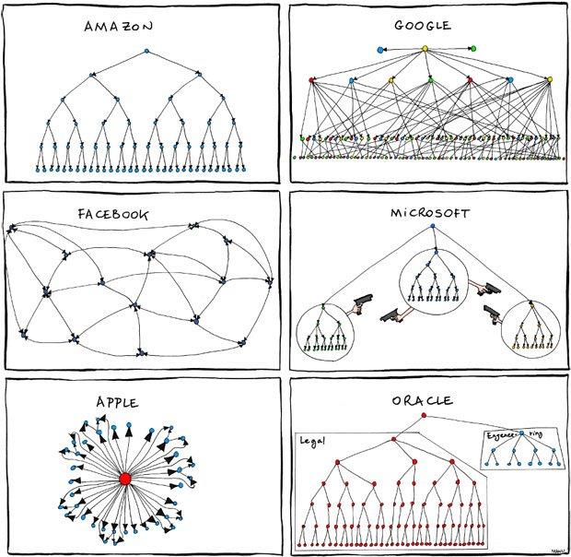
Challenging starting point for culture

Slide 27
Microsoft's Five People Priorities reinforce the emphasis on empowering people
An evolving culture with a growth mindset: "Our culture is grounded in a growth mindset, which starts with a belief that potential in nurtured, not predetermined…"
An exceptional place to work: "We believe it is our responsibility to create an environment where people can do their best work…"
Talent that can change the world: "Our aim is to recruit, develop, and retain world-changing and diverse talent…"
Transformational leadership: "We believe our leaders should empower our employees, customers, and partners to achieve more…"
Empowering at scale: "The priority is about unleashing people to come together and perform at a global scale. One way we do this is by providing technology tools that afford our employees greater connectivity, collaboration, and communication across every team…"

Slide 28
A high performance culture has three characteristics
Articulate culture in line with purpose and strategy
Activate culture through leaders who walk the talk
Embed culture in org context to sustain the change
What does great look like?
How do we make it real?
How do we make it stick?

Slide 29
Defined target culture based on five key attributes
Listen
Collaborate
Customer obsessed
One company
Growth Mindset
Diverse and inclusive
Making a difference
Expand
Contribute
Notes:
But the Heart does not end with an inspiring Purpose... Satya has put enormous emphasis on transforming Microsoft's culture. Much has been written about this... Culture-focused: huge focus here… and tons written about this. What I find most striking, and most relevant for our discussion today, is what Satya and the leadership team have placed at the center of the new culture: Growth Mindset. Not growth as in grow revenues. But growth as in Carol Dweck's brilliant work on 'Fixed vs. Growth Mindset' At the very center of his cultural transformation is an emphasis on shifting from, as he puts it, a "Know it all to a learn it all" culture... A humble approach to learning is at the very heart of the new culture. Yes it is a journey... of course... but the goal is clear. In this age of AI ... where computers ... Satya has placed the importance of human intelligence, human learning. Enabled and transformed by technology – yes – but not supplanted by it. I for one, find that very encouraging. I might even say that my heart is lifted by that...

Slide 30
Defined & clarified target culture and specific behaviors for each culture attribute
Examine your assumptions
Make a habit of asking questions
Ensure all voices are heard
Listen carefully to the person speaking until she or he feels understood
Address misunderstandings and resolve disagreements
If you have a strong reaction to someone, ask yourself why
Include and seek input from people with a wide variety of backgrounds
Take actions to reduce stressful situations
Understand each person's contributions
Be brave
Customer obsessed
Listen
Collaborate
One company
Growth Mindset
Diverse and inclusive
Making a difference
Expand
Contribute

Slide 31
Activation through leaders and aligning context key to culture change
Activation through leaders
Launched new purpose
Perf Mgmt & Recognition
Work environment
Customer obsessed
One company
Growth Mindset
People practices
Leverage Digital Tools
Diverse and inclusive
Making a difference
Hackathons
Organization structure
Development teams (Agile process)

Slide 32
Developed and launched new head, heart, and hands leadership model
Create clarity
Generate Energy
Deliver Success
Gather internal and external inputs
Distinguish insight from noise
Synthesize the complex
Draw upon full team ideas and insights
Create shared understanding
Develop clear plan of action
Inspire optimism, creativity, shared commitment and growth
Focus on own team and broader organization
Maintain energy through good times and bad
Create environment where everyone can do their best work
Build stronger organization and teams
Make things happen
Drive innovation and inspire people to go above and beyond
Find balance between long-term and short-term successes
Be boundary less in delivering solutions

Slide 33
Microsoft employed the four chambers of the heart
Activated purpose through nationwide leadership events, followed up by tangible actions
Articulated culture behaviors consistent with purpose and are aligning the context to sustain culture
Proactively put in place programs for employees disrupted by the change
Implemented a new leadership model

Slide 34
Satya Nadella's view on the heart of transformation
The most useful thing I’ve done is to anchor us on that sense of purpose and mission… Reinforcing our mission and culture has been pivotal…
ND 16.Aug.19: Voiceover: You may remember hearing from Satya about how they do this…. Let's hear again. Purpose + Culture points from his vid.
Film Link:
https://bcg01.egnyte.com/dl/fo6kVZAMAM/

Slide 35
For reflection…
Reflecting on the heart
Are you getting power from your purpose?
Is your culture empowering your people?
Are you caring for people through the change journey?
As leaders, are you leading with head, heart, and hands?

Slide 36
For Reflection
Head
Have you envisioned the digitally-enabled, growth-oriented future you aspire to?
Have you defined the right big rocks?
Is your leadership team aligned?
Have you clarified the case for change?
Heart
Are you getting power from your purpose?
Is your culture empowering your people?
Are you demonstrating extreme care?
Are your leaders leading with head, heart, and hands?
Hands
Have you ensured executional discipline?
Are your leaders collaborating around the big rocks?
Are you using agile ways of working?
Are you building capabilities as you execute?
Notes:
As I close my presentation and open up for questions, I'll leave you with a few questions for Reflection...

